Slide 1
The Limits to Growth: Sustainability and the Circular Economy
Lecture 1: Introduction
Prof. Dr. Benjamin Leiding
M.A. Theresa Sommer

Slide 2
License
This work is licensed under a Creative Commons Attribution-ShareAlike 4.0 International License. To view a copy of this license, please refer to https://creativecommons.org/licenses/by-sa/4.0/ .
Updated versions of these slides will be available in our Github repository.

Slide 3
Question 1
How old are you?
→ Type your response in the poll field.

Slide 4
Question 2
At which university do you study?
a) TU Clausthal
b) Ostfalia
c) Göttingen
d) other / not a student

Slide 5
Question 3
What do you study?
→ Type your response in the poll field.

Slide 6
Question 4
Do you think that the current actions taken to address climate change and environmental pollution are sufficient and appropriate to ensure a future for you and your children?
Yes
No
Not sure

Slide 7
Question 5
Are you involved in any climate change or sustainability movement / organization / party / etc. – if yes, which one?
No? → Type “no”
Yes? → Type the name/abbreviation, e.g., “XR” (Extinction Rebellion), “FF” (Fridays for Future), etc.

Slide 8
Question 6
Would you like to attend the lecture and Q&A live in Goslar?
Yes
No

Slide 9
An Inconvenient Problem

Slide 10
What is the Problem?

Slide 11
What is the Problem?
We only have one planet and we are ruining it.

Slide 12

We Only Have One Planet
Climate Change – Global GHG Emission Pathways (2019)
Hannah Ritchie and Max Roser, adapted for svg and smartphone by Eric Fisk – https://commons.wikimedia.org/wiki/File:Greenhouse_gas_emission_scenarios_01.svg – CC BY-SA 4.0.

Slide 13
We Only Have One Planet
Climate Change – 1.5°C vs. 2/3/4°C
“If we can keep warming below 3°C we likely remain within our adaptive capacity as a civilization, but at 2.7°C warming we would experience great hardship.” - Prof. Michael Mann

Slide 14
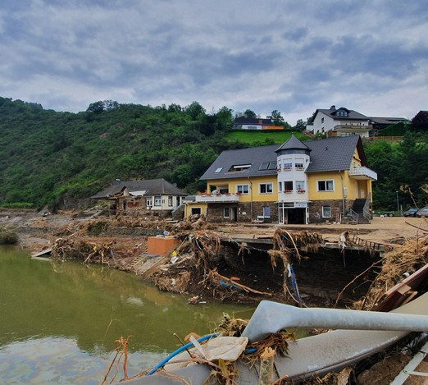
We Only Have One Planet
Climate Change – Floods and Droughts
1. Bettina Vier – https://commons.wikimedia.org/wiki/File:Altenahr_-_8_Tage_nach_der_Flut_-_Volksbank.jpg – CC BY-SA 4.0.
2. + 3. Sören Kraft – https://commons.wikimedia.org/wiki/File:Okerstausee_Niedrigwasser.jpg – CC BY-SA 3.0.
4. ILRI – https://www.flickr.com/photos/ilri/24223476605 – CC BY-NC-ND 2.0.

Slide 15
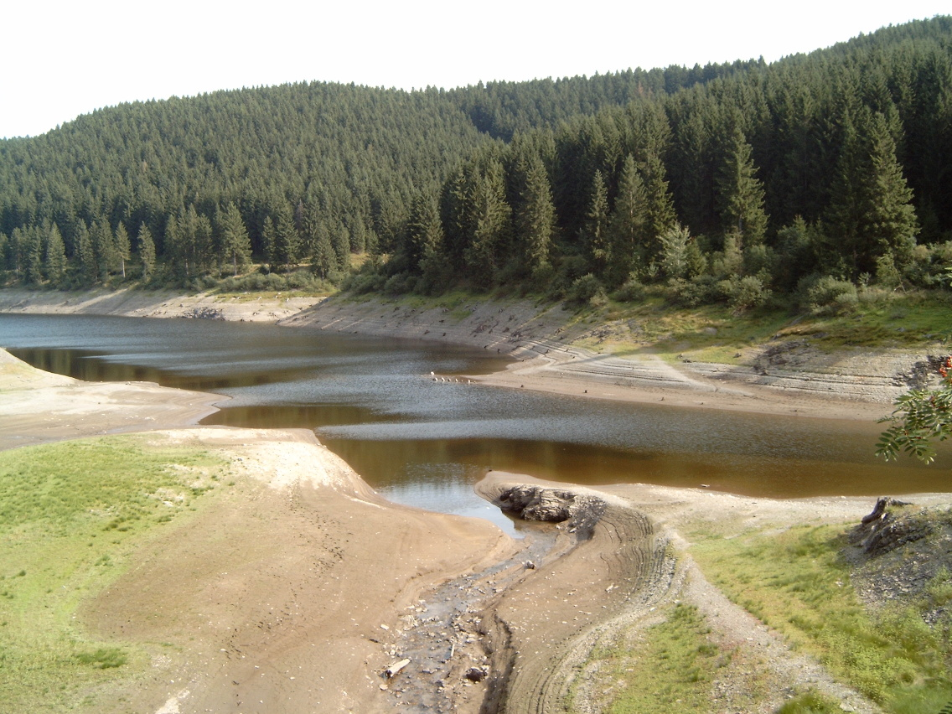
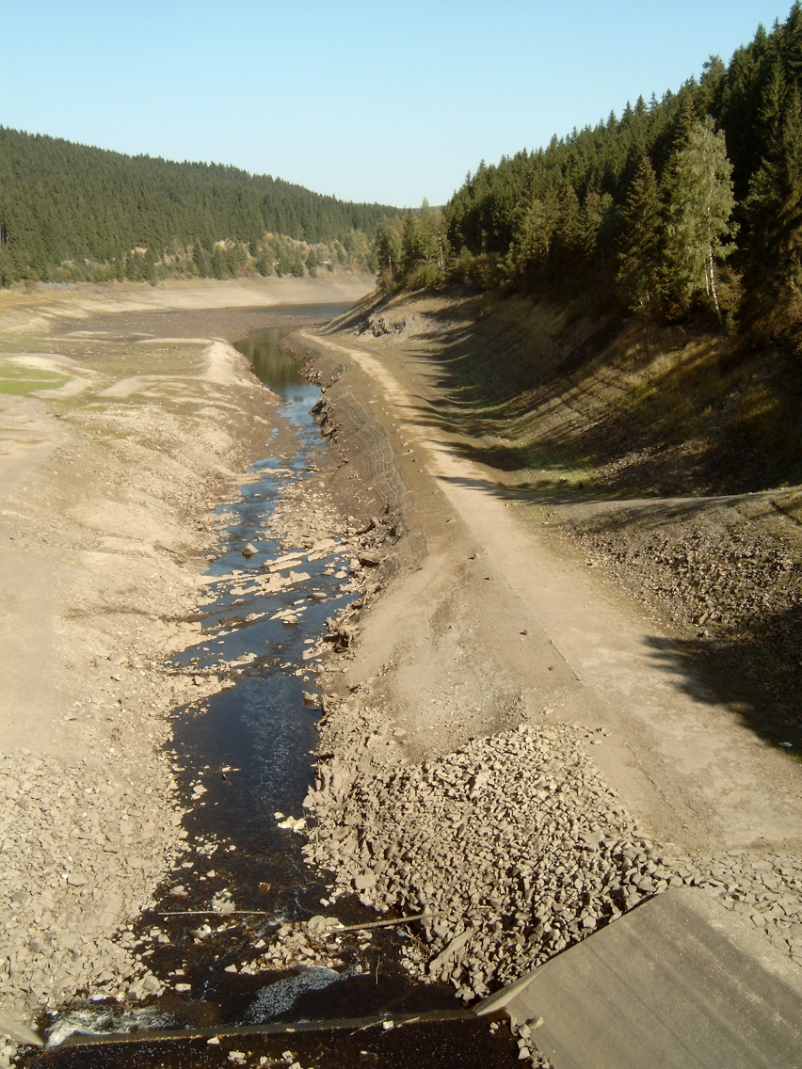
We Only Have One Planet
Climate Change – Floods and Droughts
1. Bettina Vier – https://commons.wikimedia.org/wiki/File:Altenahr_-_8_Tage_nach_der_Flut_-_Volksbank.jpg – CC BY-SA 4.0.
2. + 3. Sören Kraft – https://commons.wikimedia.org/wiki/File:Okerstausee_Niedrigwasser.jpg – CC BY-SA 3.0.
4. ILRI – https://www.flickr.com/photos/ilri/24223476605 – CC BY-NC-ND 2.0.

Slide 16
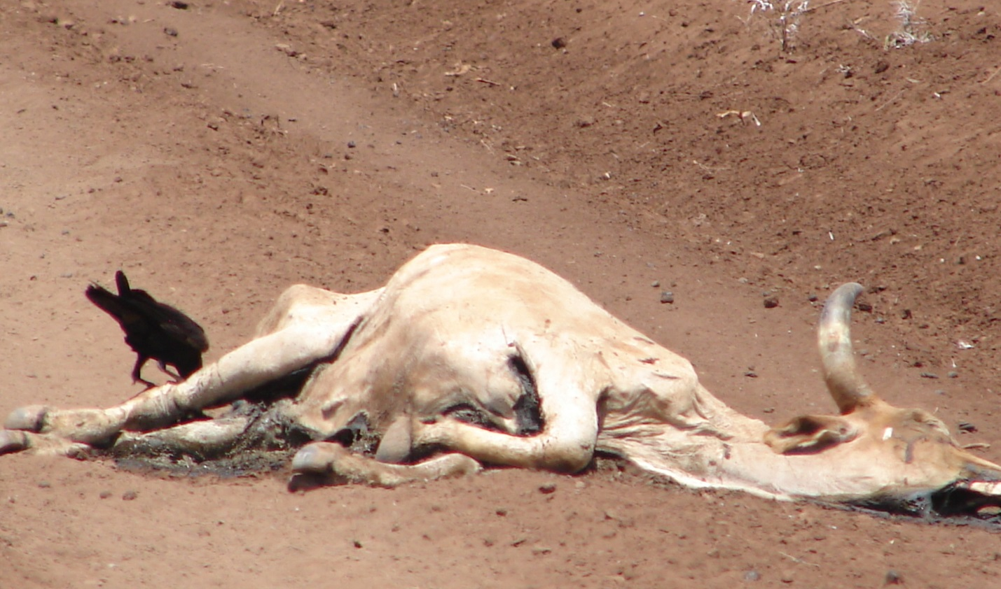
We Only Have One Planet
Climate Change – Floods and Droughts
1. Bettina Vier – https://commons.wikimedia.org/wiki/File:Altenahr_-_8_Tage_nach_der_Flut_-_Volksbank.jpg – CC BY-SA 4.0.
2. + 3. Sören Kraft – https://commons.wikimedia.org/wiki/File:Okerstausee_Niedrigwasser.jpg – CC BY-SA 3.0.
4. ILRI – https://www.flickr.com/photos/ilri/24223476605 – CC BY-NC-ND 2.0.

Slide 17
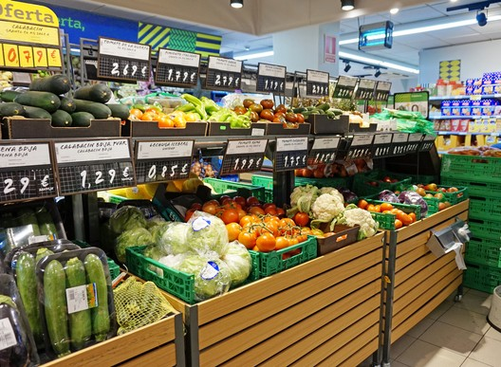
We Only Have One Planet
Climate Change – Famine
1. Tiia Monto – https://commons.wikimedia.org/wiki/File:Vegetables_in_supermarket.jpg – CC BY-SA 3.0.
2. Martin Shaw – https://commons.wikimedia.org/wiki/File:Vegetable_section_empty_in_a_supermarket_in_Kenmore.jpg – CC BY 2.0.

Slide 18
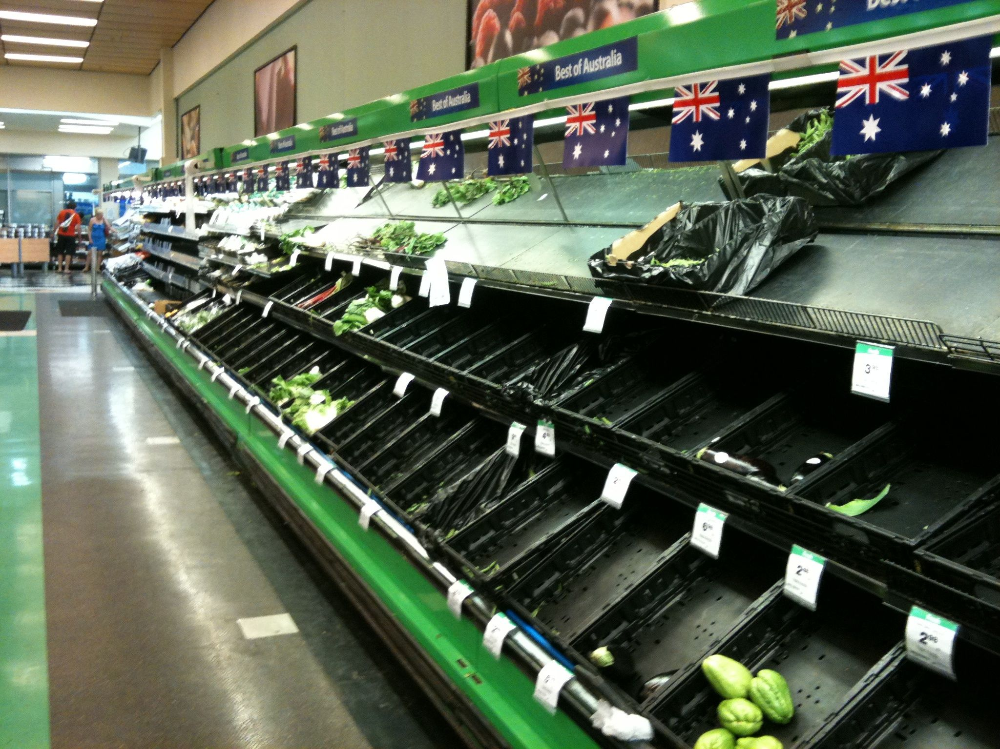
We Only Have One Planet
Climate Change – Famine
1. Tiia Monto – https://commons.wikimedia.org/wiki/File:Vegetables_in_supermarket.jpg – CC BY-SA 3.0.
2. Martin Shaw – https://commons.wikimedia.org/wiki/File:Vegetable_section_empty_in_a_supermarket_in_Kenmore.jpg – CC BY 2.0.

Slide 19

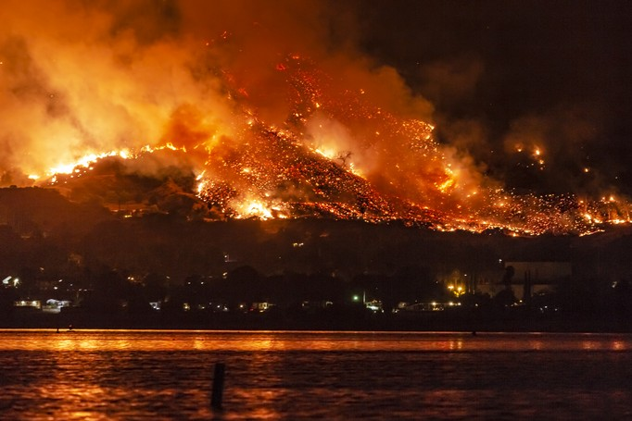
We Only Have One Planet
Climate Change – Wildfires
1. Bruce Detorres – https://www.flickr.com/photos/brucedetorres/49352689768 – Public Domain.
2. slworking2 – https://www.flickr.com/photos/slworking/29034137667 – CC BY-NC-SA 2.0.

Slide 20
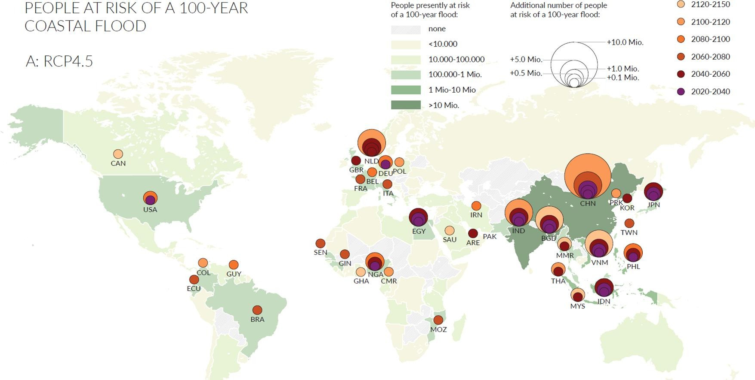
We Only Have One Planet
Climate Change – Rising Sea Level
M. Haasnoot, G. Winter, S. Brown, R. J. Dawson, P. J. Ward, D. Eilander (2021.) Long-term sea-level rise necessitates a commitment to adaptation: A first order assessment (Link) – CC BY-NC-ND 4.0.

Slide 21
We Only Have One Planet
Climate Change – Rising Sea Level
What’s the problem?

Slide 22
We Only Have One Planet
Climate Change – Rising Sea Level
What’s the problem?

Slide 23
We Only Have One Planet
Climate Change – Rising Sea Level
What’s the problem?

Slide 24
We Only Have One Planet
Climate Change – Rising Sea Level
What’s the problem?

Slide 25
We Only Have One Planet
Climate Change – Rising Sea Level
What’s the problem?
?

Slide 26
We Only Have One Planet
Climate Change – Extreme Weather Events
Catastrophe is the new “normal”
Extreme weather events occur more often and with increased intensity
100 year floods/droughts/etc. occur every 10 years

Slide 27
We Only Have One Planet
Climate Change – Extreme Weather Events
Catastrophe is the new “normal”
Extreme weather events occur more often and with increased intensity
100 year floods/droughts/etc. occur every 10 years
→ More and more parts of the world will become uninhabitable

Slide 28
We Only Have One Planet
Climate Change – Extreme Weather Events
Catastrophe is the new “normal”
Extreme weather events occur more often and with increased intensity
100 year floods/droughts/etc. occur every 10 years
→ More and more parts of the world will become uninhabitable
→ More inhabitants per m² that need to be cared for under extreme conditions

Slide 29
We Only Have One Planet
Climate Change
“change is coming, whether you like it or not”
Greta Thunberg
Click Me
Guardian News (2019) – https://www.youtube.com/watch?v=TMrtLsQbaok

Slide 30
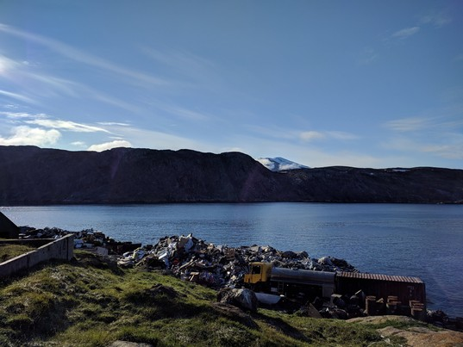
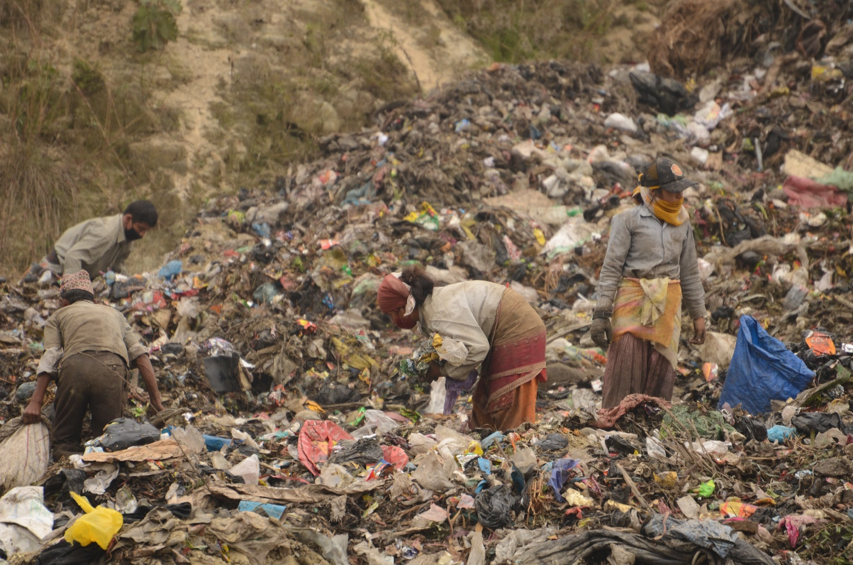
We Only Have One Planet
Environmental Pollution – Waste
1. "Landfill at Upernavik" by ulalume – https://www.flickr.com/photos/96649248@N00/43867280734 – CC BY-NC-ND 2.0.
2. Christian Hüpfer – https://flic.kr/p/aKXw2F – CC BY-SA 2.0.

Slide 31
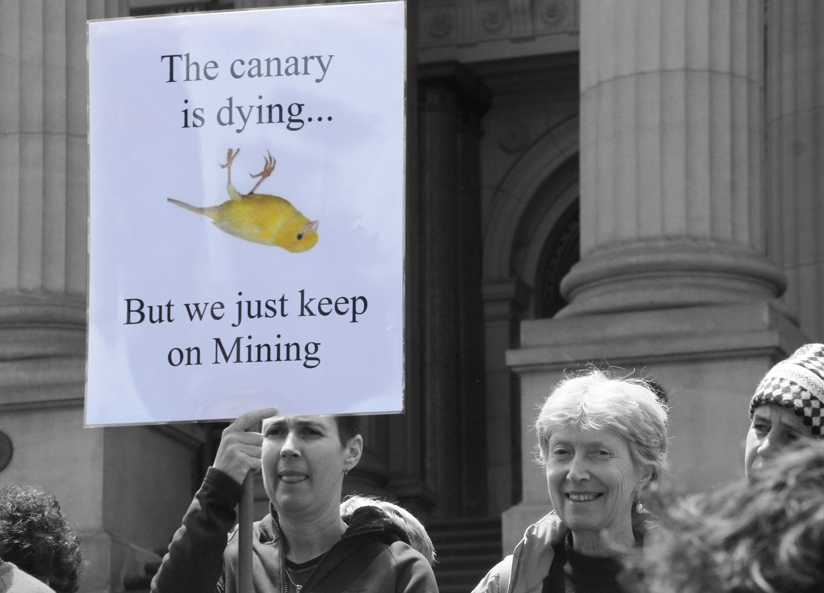
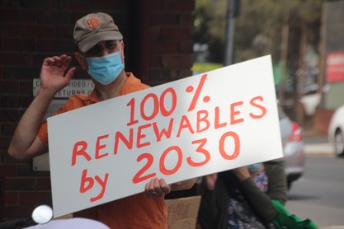
We Only Have One Planet
Environmental Pollution – Fossil Fuels
3 of the 10 dirtiest european coal plants are located in Poland
In which country/countries are the other 7 dirtiest coal plants located?
f the 10 dirtiest european coal plants are located in GERMANY
1. https://ember-climate.org/insights/research/top-10-emitters-in-the-eu-ets-2021/
2. John Englart – https://www.flickr.com/photos/takver/11308053925/ – CC BY-SA 2.0.
3. John Englart – https://www.flickr.com/photos/takver/51658831095/ – CC BY-SA 2.0.

Slide 32
We Only Have One Planet
Environmental Pollution – Fossil Fuels
3 of the 10 dirtiest European coal plants are located in Poland
In which country/countries are the other 7 dirtiest coal plants located?
7 of the 10 dirtiest European coal plants are located in GERMANY
1. https://ember-climate.org/insights/research/top-10-emitters-in-the-eu-ets-2021/
2. John Englart – https://www.flickr.com/photos/takver/11308053925/ – CC BY-SA 2.0.
3. John Englart – https://www.flickr.com/photos/takver/51658831095/ – CC BY-SA 2.0.

Slide 33
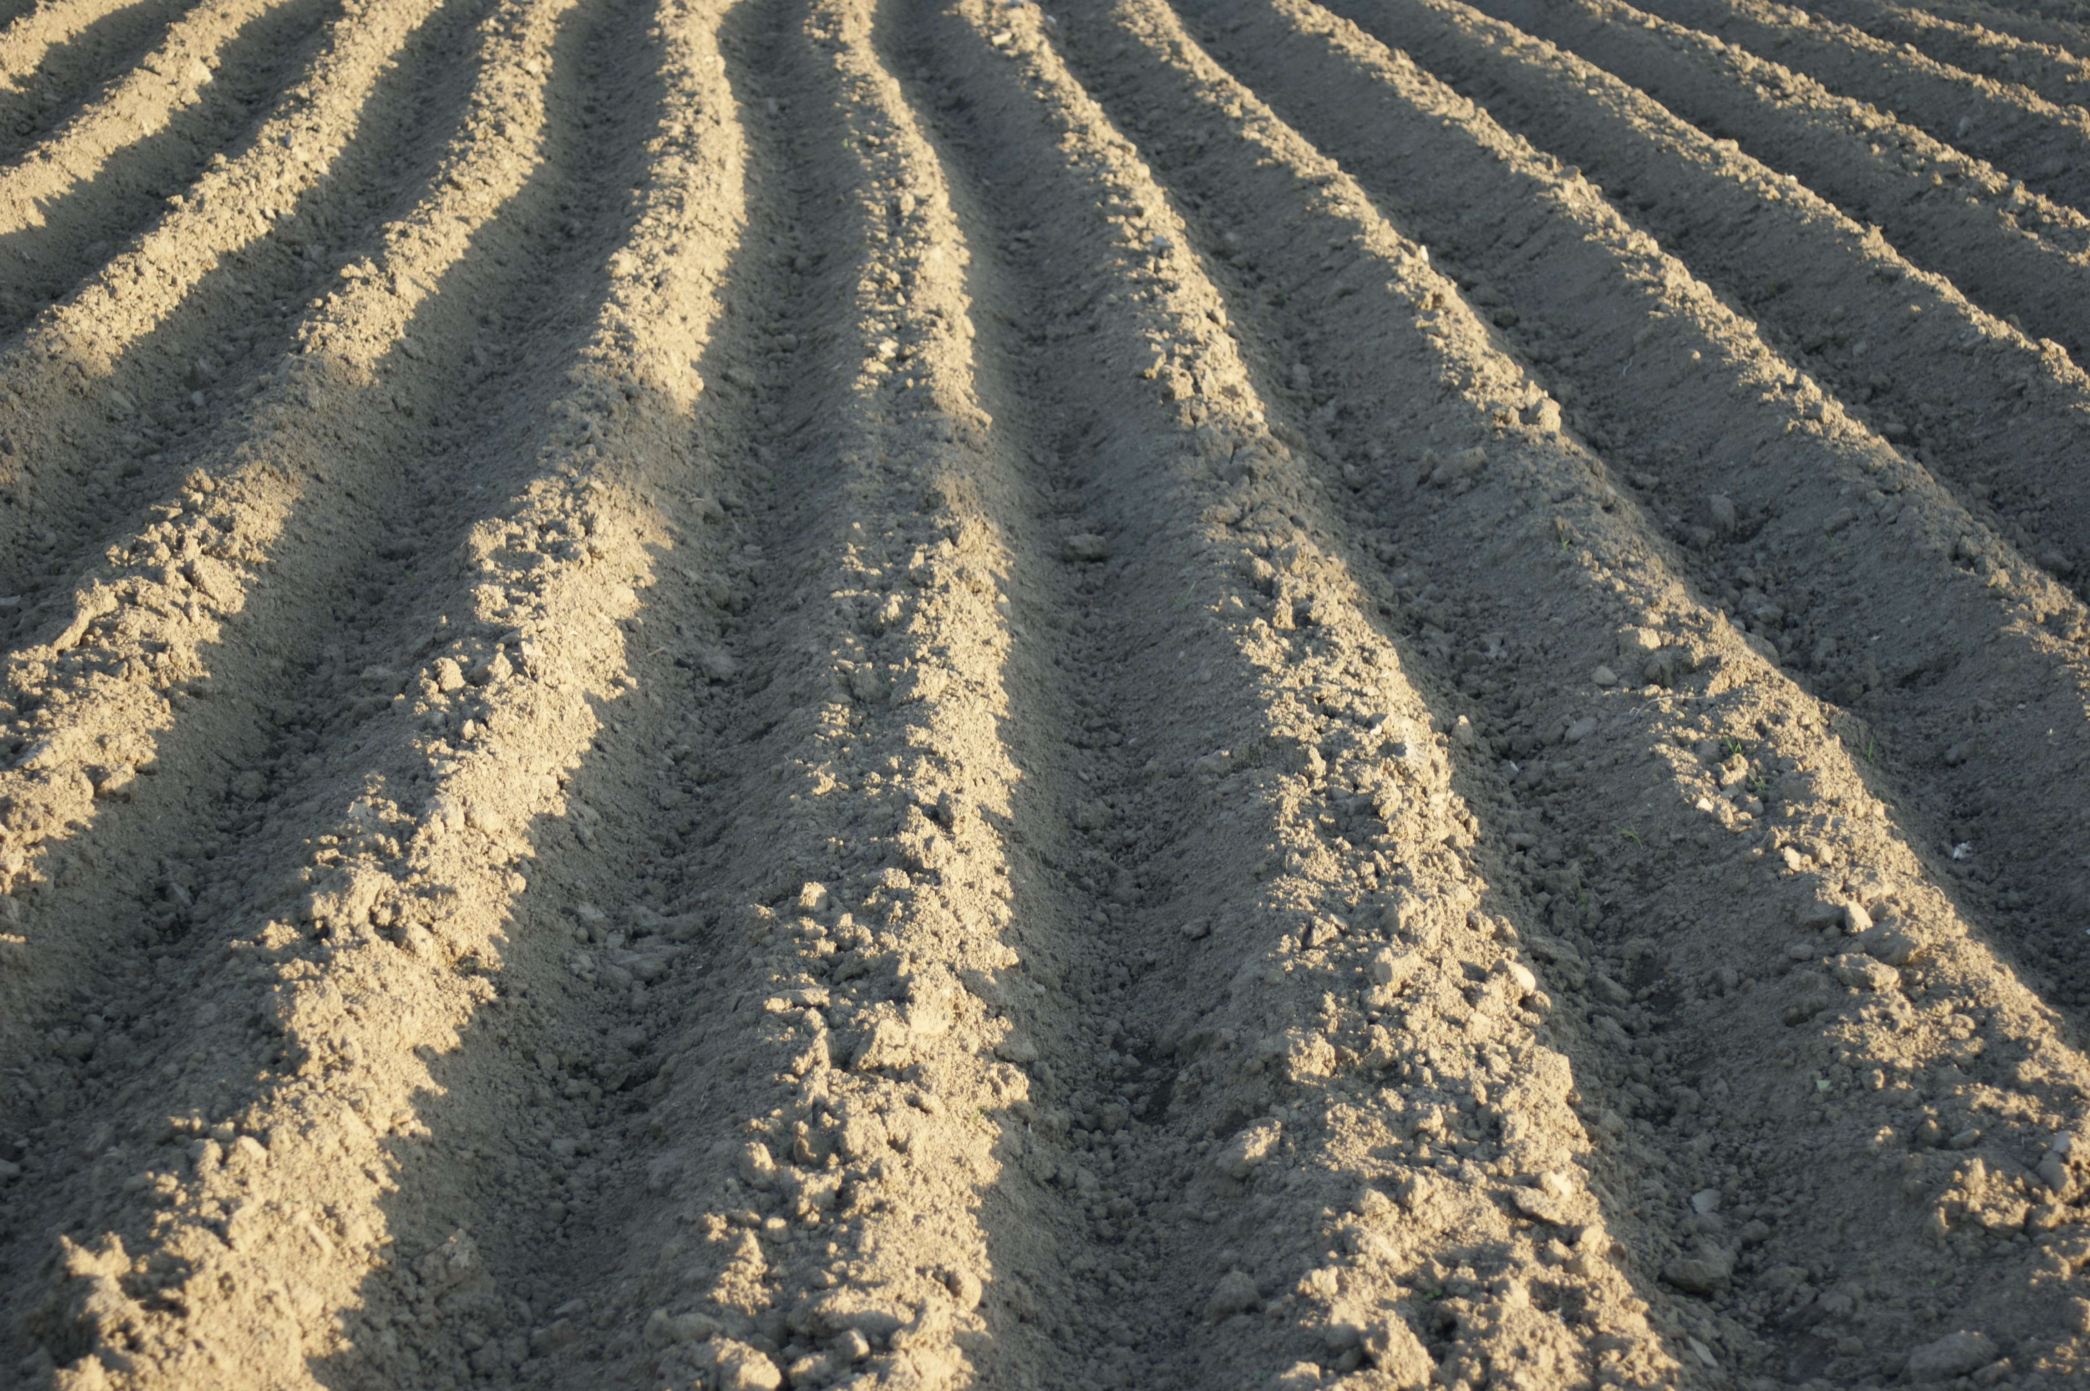
We Only Have One Planet
Environmental Pollution – Barren Land
https://pxhere.com/en/photo/1040531 – Public Domain

Slide 34
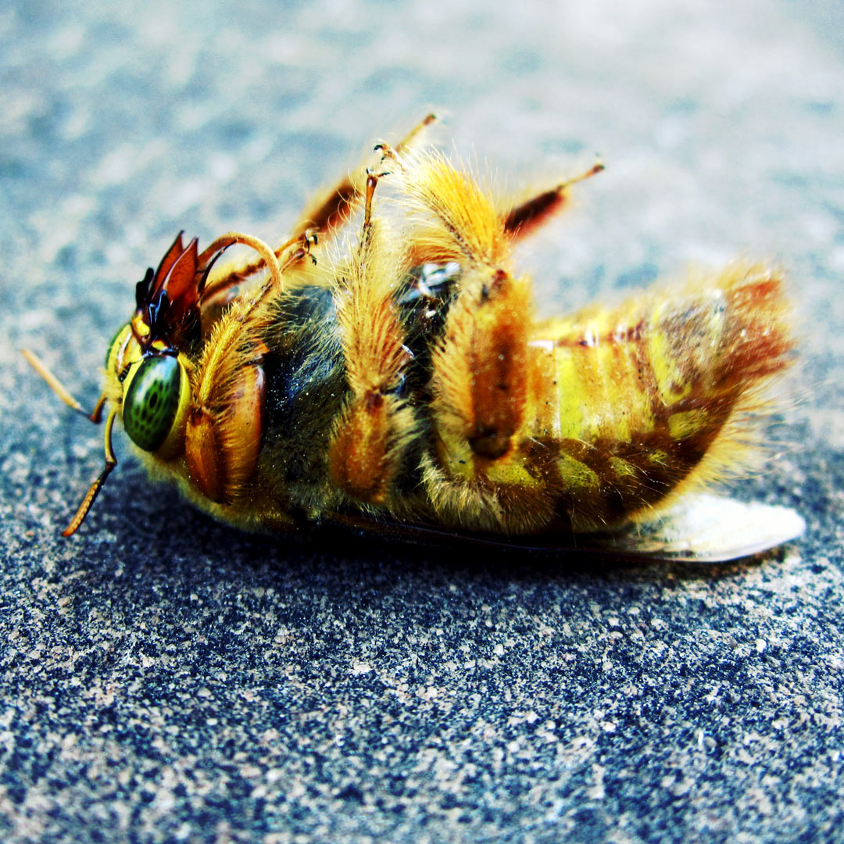
We Only Have One Planet
Environmental Pollution – Mass Extinction
Roughly 8 million species on Earth (incl. 5.5 million insect species)
Up to 1 million: species threatened with extinction, many within decades
More than 40% of amphibian species threatened with extinction
1. https://www.un.org/sustainabledevelopment/blog/2019/05/nature-decline-unprecedented-report/
2. Russ Morris – https://www.flickr.com/photos/russmorris/28320602639 – CC BY-NC-ND 2.0.

Slide 35
We Only Have One Planet
Environmental Pollution – Mass Extinction
Roughly 8 million species on Earth (incl. 5.5 million insect species)
Up to 1 million: species threatened with extinction, many within decades
More than 40% of amphibian species threatened with extinction
1. https://www.un.org/sustainabledevelopment/blog/2019/05/nature-decline-unprecedented-report/
2. Russ Morris – https://www.flickr.com/photos/russmorris/28320602639 – CC BY-NC-ND 2.0.

Slide 36
We Only Have One Planet
Environmental Pollution – Mass Extinction
Roughly 8 million species on Earth (incl. 5.5 million insect species)
Up to 1 million: species threatened with extinction, many within decades
More than 40% of amphibian species threatened with extinction
1. https://www.un.org/sustainabledevelopment/blog/2019/05/nature-decline-unprecedented-report/
2. Russ Morris – https://www.flickr.com/photos/russmorris/28320602639 – CC BY-NC-ND 2.0.

Slide 37

We Only Have One Planet
Resources – Overconsumption
Earth Overshoot Day
1970-2022
1 Earth
1.75 Earths
December
November
October
September
August
July
June
May
April
March
February
January
Figure adapted from https://www.overshootday.org/newsroom/past-earth-overshoot-days/

Slide 38
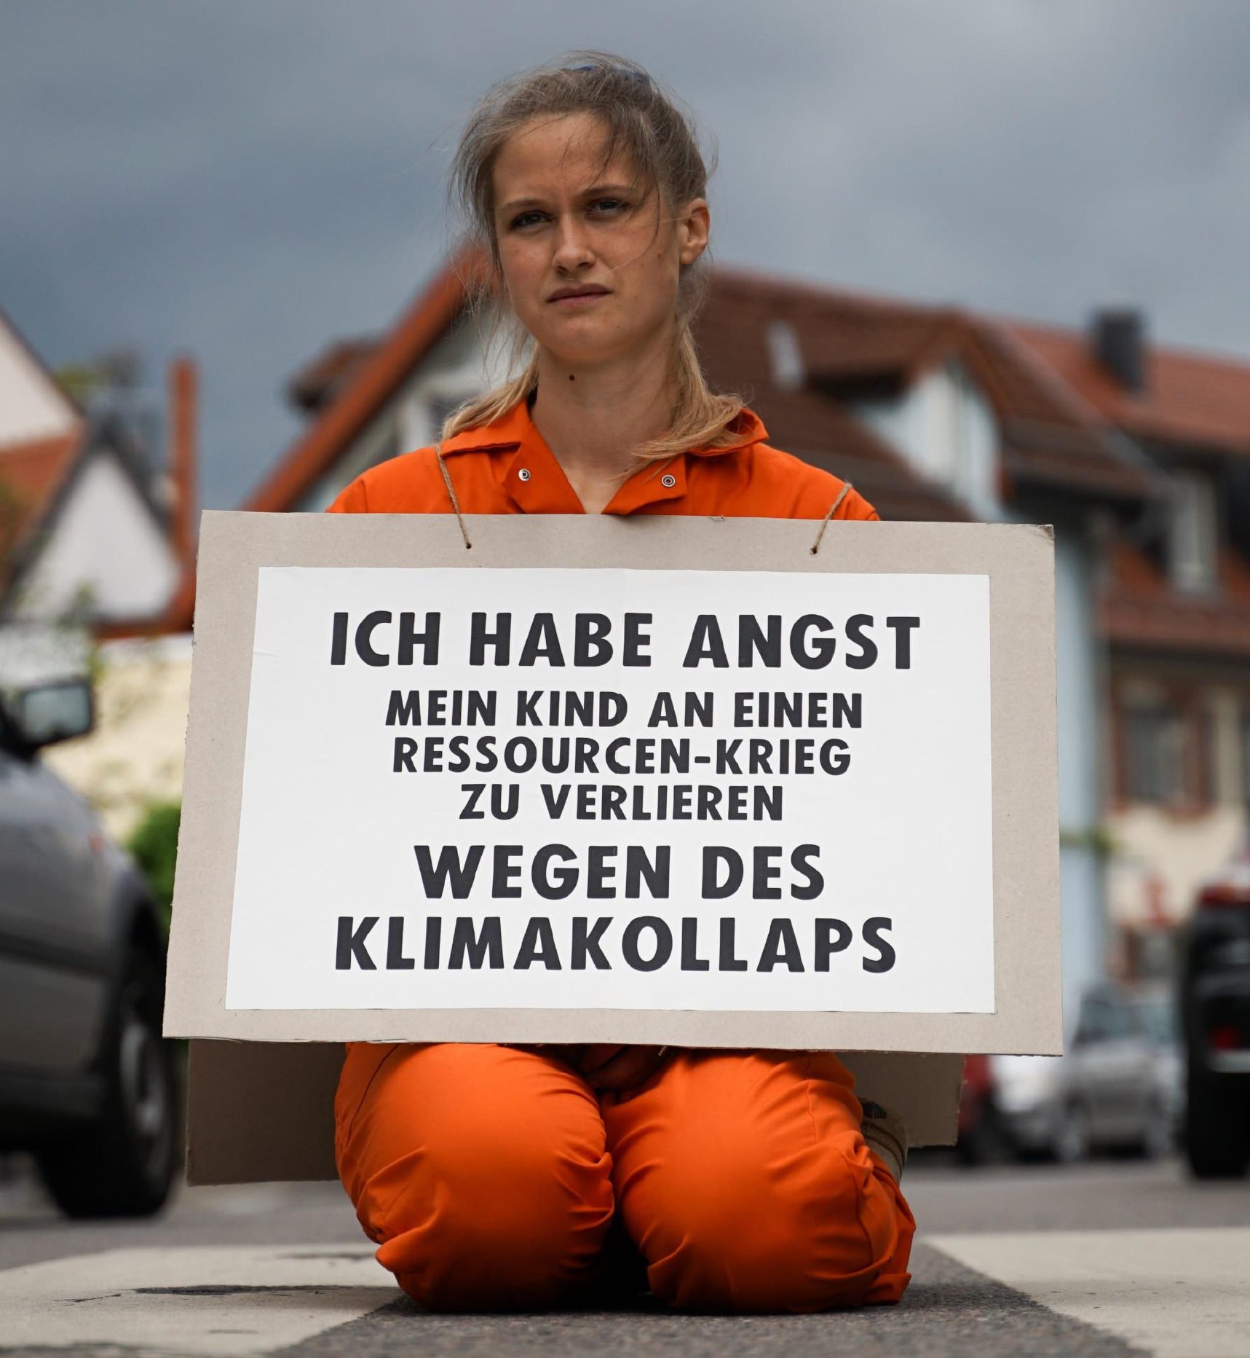
We Only Have One Planet
Resources
“I am afraid of losing my child to a resource war because of a climate collapse”
XR Strategiepapier 2022 – Pusteblumen und Hype. Bilder: Sebastian Höhn, Joe Pohl, Sandra Doneck, Alessandro Brönnimann

Slide 39
We Only Have One Planet
Resources
“I am afraid of losing my child to a resource war because of a climate collapse”
→ “Our parents will die of old age, our children will die of climate change”
XR Strategiepapier 2022 – Pusteblumen und Hype. Bilder: Sebastian Höhn, Joe Pohl, Sandra Doneck, Alessandro Brönnimann

Slide 40
3 Key Challenges of the 21st Century
Climate change / adaption to climate change
Environmental pollution
Dwindling non-renewable resources

Slide 41
Is this really still a Problem?

Slide 42
Is This Really Still a Problem?
Yes!

Slide 43
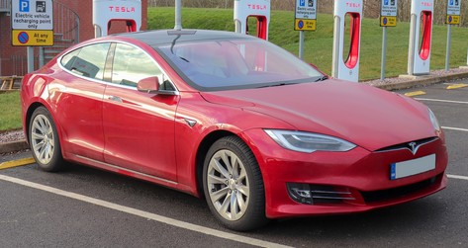
Is This Really Still a Problem?
1. Vauxford – https://commons.wikimedia.org/wiki/File:2018_Tesla_Model_S_75D.jpg – CC BY-SA 4.0.
2. Marco Verch – https://www.flickr.com/photos/30478819@N08/51303997289/in/photostream/ – CC BY 2.0.
3. https://pxhere.com/en/photo/1081335 – CC0 1.0.
4. epSos.de – https://commons.wikimedia.org/wiki/File:Colorful_Recycling_Containers_for_Trash.jpg – CC BY 2.0.

Slide 44

Is This Really Still a Problem?
1. Vauxford – https://commons.wikimedia.org/wiki/File:2018_Tesla_Model_S_75D.jpg – CC BY-SA 4.0.
2. Marco Verch – https://www.flickr.com/photos/30478819@N08/51303997289/in/photostream/ – CC BY 2.0.
3. https://pxhere.com/en/photo/1081335 – CC0 1.0.
4. epSos.de – https://commons.wikimedia.org/wiki/File:Colorful_Recycling_Containers_for_Trash.jpg – CC BY 2.0.

Slide 45
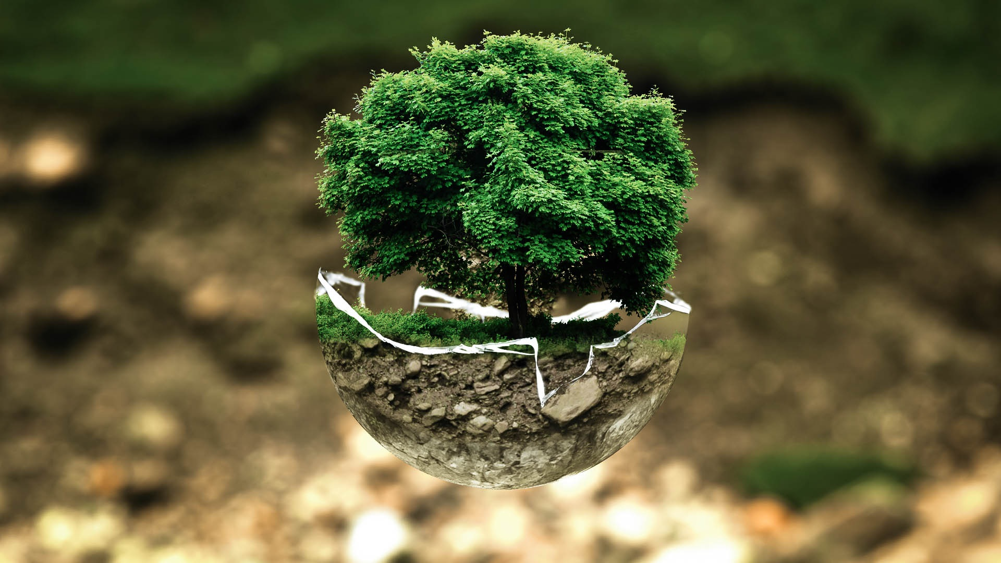
Is This Really Still a Problem?
1. Vauxford – https://commons.wikimedia.org/wiki/File:2018_Tesla_Model_S_75D.jpg – CC BY-SA 4.0.
2. Marco Verch – https://www.flickr.com/photos/30478819@N08/51303997289/in/photostream/ – CC BY 2.0.
3. https://pxhere.com/en/photo/1081335 – CC0 1.0.
4. epSos.de – https://commons.wikimedia.org/wiki/File:Colorful_Recycling_Containers_for_Trash.jpg – CC BY 2.0.

Slide 46
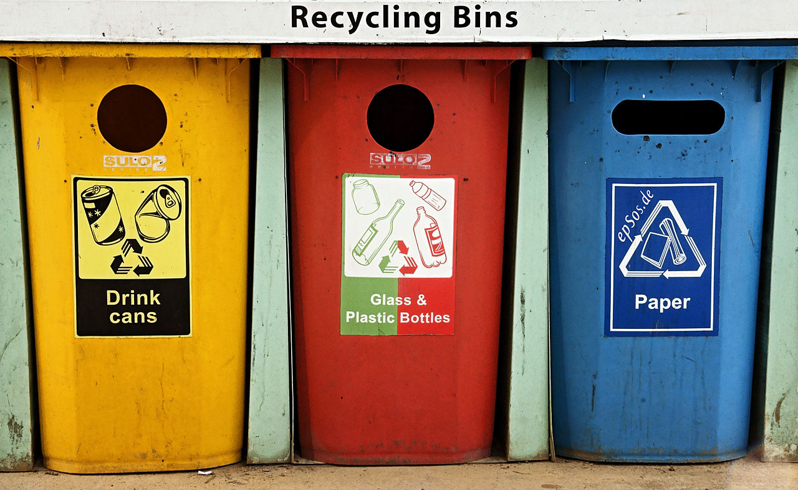
Is This Really Still a Problem?
1. Vauxford – https://commons.wikimedia.org/wiki/File:2018_Tesla_Model_S_75D.jpg – CC BY-SA 4.0.
2. Marco Verch – https://www.flickr.com/photos/30478819@N08/51303997289/in/photostream/ – CC BY 2.0.
3. https://pxhere.com/en/photo/1081335 – CC0 1.0.
4. epSos.de – https://commons.wikimedia.org/wiki/File:Colorful_Recycling_Containers_for_Trash.jpg – CC BY 2.0.

Slide 47
There Is No Hope
“As a climate scientist, I am often asked to talk about hope. Particularly in the current political climate, audiences want to be told that everything will be all right in the end. […]
Climate change is bleak, the organizers always say. Tell us a happy story. Give us hope. The problem is, I don’t have any. […]
We are inevitably sending our children to live on an unfamiliar planet.”
Kate Marvel (2018) – We Need Courage, Not Hope, to Face Climate Change – https://onbeing.org/blog/kate-marvel-we-need-courage-not-hope-to-face-climate-change/

Slide 48
We Need Courage
“But the opposite of hope is not despair. It is grief. Even while resolving to limit the damage, we can mourn. And here, the sheer scale of the problem provides a perverse comfort: we are in this together. The swiftness of the change, its scale and inevitability, binds us into one, broken hearts trapped together under a warming atmosphere.
We need courage, not hope. Grief, after all, is the cost of being alive. [...] Courage is the resolve to do well without the assurance of a happy ending.”
Kate Marvel (2018) – We Need Courage, Not Hope, to Face Climate Change – https://onbeing.org/blog/kate-marvel-we-need-courage-not-hope-to-face-climate-change/

Slide 49
We Need Courage
“But the opposite of hope is not despair. It is grief. Even while resolving to limit the damage, we can mourn. And here, the sheer scale of the problem provides a perverse comfort: we are in this together. The swiftness of the change, its scale and inevitability, binds us into one, broken hearts trapped together under a warming atmosphere.
We need courage, not hope. Grief, after all, is the cost of being alive. [...] Courage is the resolve to do well without the assurance of a happy ending.”
Kate Marvel (2018) – We Need Courage, Not Hope, to Face Climate Change – https://onbeing.org/blog/kate-marvel-we-need-courage-not-hope-to-face-climate-change/

Slide 50
Question 7
What percentage of the population needs to participate in peaceful protest/civil disobedience for political change, i.e., saving our planet?
→ Type your response in the poll field.
→ According to Prof. Erica Chenoweth 3.5%
→ Based on studying 323 violent and non-violent protests that occurred between 1900 and 2006 worldwide).

Slide 51
Question 7
What percentage of the population needs to participate in peaceful protest/civil disobedience for political change, i.e., saving our planet?
→ Type your response in the poll field.
→ According to Prof. Erica Chenoweth 3.5%
→ Based on studying 323 violent and non-violent protests that occurred between 1900 and 2006 worldwide).
https://www.ericachenoweth.com/research

Slide 52
Basic Law for the Federal Republic of Germany
Article 20a – Protection of the natural foundations of life and animals
“Mindful also of its responsibility towards future generations, the state shall protect the natural foundations of life and animals by legislation and, in accordance with law and justice, by executive and judicial action, all within the framework of the constitutional order.”
German: “Der Staat schützt auch in Verantwortung für die künftigen Generationen die natürlichen Lebensgrundlagen und die Tiere im Rahmen der verfassungsmäßigen Ordnung durch die Gesetzgebung und nach Maßgabe von Gesetz und Recht durch die vollziehende Gewalt und die Rechtsprechung.”
https://www.gesetze-im-internet.de/englisch_gg/englisch_gg.html#p0116

Slide 53
What is this course all About?

Slide 54
3 Key Challenges of the 21st Century
Climate change / adaption to climate change
Environmental pollution
Dwindling non-renewable resources

Slide 55
What Is This Course All About?
In a Nutshell
This course is supposed to enable YOU to create a sustainable future for all of us and future generations.

Slide 56
What Is This Course All About?
Gaining an understanding of causes, dimensions, and the characterization of the 3 key challenge of the 21st century
Climate change / adaption to climate change
Environmental pollution
Dwindling non-renewable resources
Critically assess available solutions
Act before it is to late

Slide 57
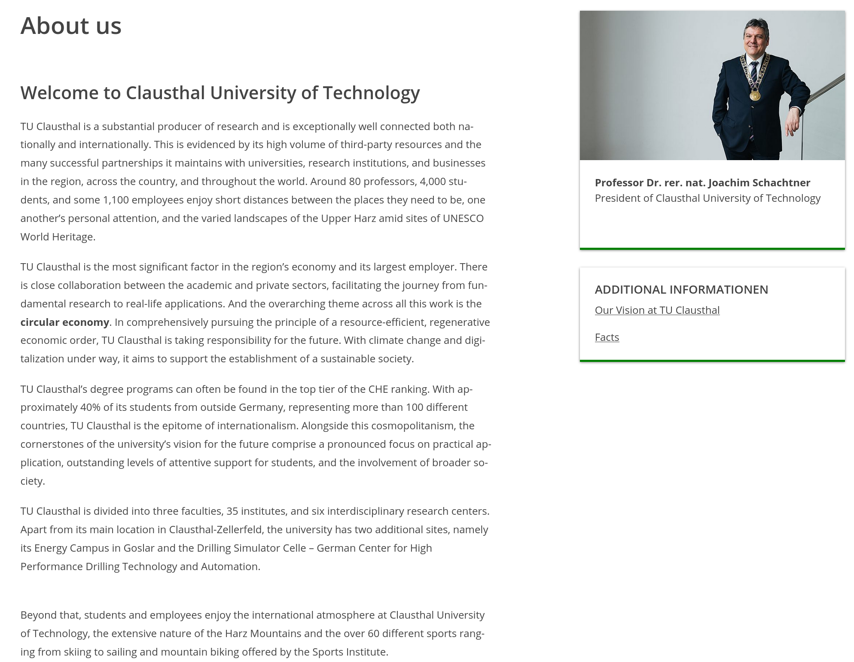
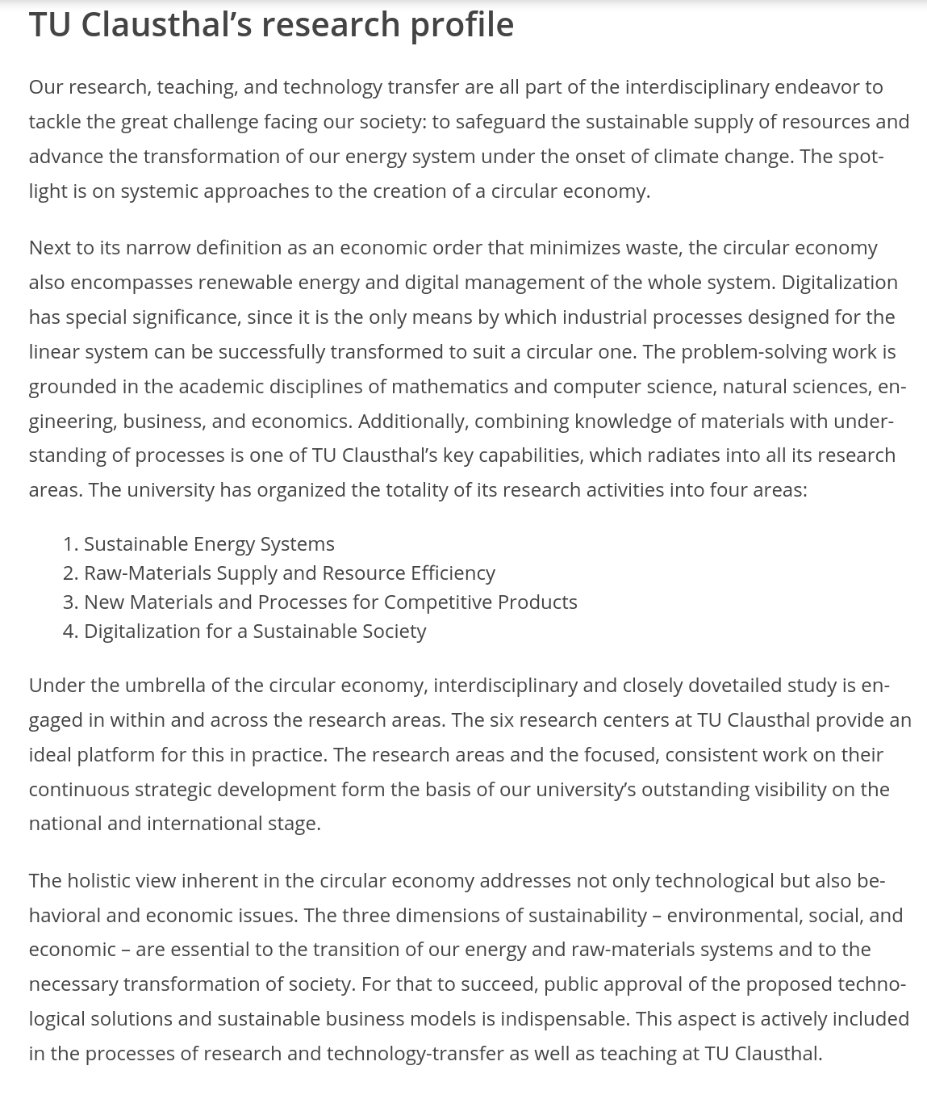
What Is This Course All About?
Clausthal University of Technology – Research Profile
https://www.tu-clausthal.de/en/university/about-us
Notes:
<number>

Slide 58
What This Course Is Not
A comforting fairy tale of:
“Everything will be fine”
“Business as usual is sufficient”
“Just make this minor change to your daily lifestyle and recycle plastic bags”
A soothing high-definition TikTok video
A place to discuss whether climate change is “real”

Slide 59
What Is This Course All About?
Strategy
Strategy is “turning resources you have into the power you need to get what you want
→ your goal. [Marshall Ganz]
Strategic Goal (what you want): The goal is a clear, measurable point that allows you to know if you’ve won or lost, and that meets the challenge your constituency faces.
Power (what you need): tactics through which you can turn your resources into the capacity you need to achieve your goal.
Resources (what your constituency has): time, money, skills, relationships, etc.

Slide 60
What Is This Course All About?
Strategy
Strategy is “turning resources you have into the power you need to get what you want
→ your goal. [Marshall Ganz]
Strategic Goal (what you want): The goal is a clear, measurable point that allows you to know if you’ve won or lost, and that meets the challenge your constituency faces.
Power (what you need): tactics through which you can turn your resources into the capacity you need to achieve your goal.
Resources (what your constituency has): time, money, skills, relationships, etc.

Slide 61
What Is This Course All About?
Strategy
Strategy is “turning resources you have into the power you need to get what you want
→ your goal. [Marshall Ganz]
Strategic Goal (what you want): The goal is a clear, measurable point that allows you to know if you’ve won or lost, and that meets the challenge your constituency faces.
Power (what you need): tactics through which you can turn your resources into the capacity you need to achieve your goal.
Resources (what your constituency has): time, money, skills, relationships, etc.

Slide 62
What Is This Course All About?
Strategy
Strategy is “turning resources you have into the power you need to get what you want
→ your goal. [Marshall Ganz]
Strategic Goal (what you want): The goal is a clear, measurable point that allows you to know if you’ve won or lost, and that meets the challenge your constituency faces.
Power (what you need): tactics through which you can turn your resources into the capacity you need to achieve your goal.
Resources (what your constituency has): time, money, skills, relationships, etc.

Slide 63
Additional Resources
Chenoweth, E. (2013). The success of nonviolent resistance – Link

Slide 64
Exercise E01

Slide 65
Exercise E04
Defining Sustainability
We are interested to know what you might already know about “sustainability” and what your current understanding of it is.
1. Record a short video (max. 60 seconds) in which you answer the following questions:
What do you understand under “sustainability”?
Does sustainability play a role in your personal life? If yes, please explain how.
2. Submit your result in a common video file format (e.g. mp4, avi, 3gp, mov, etc.). Please add your full name to the filename!
Note: If you are unable to record your answers in a video, instead write them down in a short essay (max. 200 words) and submit it as a pdf file.
You can find the full task sheet here. (Link)
Link for Submission: https://sync.academiccloud.de/index.php/s/MW3wY8uOVJbTrei

Slide 66
Questions?

